Slide 1
Heart Disease Prediction
Rezaei Barzani Mohammad, Zoleikani Pouya, Barot Krupa,
Borzai Daniel, Amantay Rassul

Slide 2
Domain Context – Why Heart Disease Prediction Matter
Why It Matters
Leading global killer: ~17.9 million deaths/year (WHO)
Early detection = prevention:
Lifestyle changes
Timely medication
Improved outcomes & reduced hospital costs
Clinical Relevance
Risk scoring (e.g., Framingham, ASCVD)
Guides treatment (e.g., statins, antihypertensives)
Tracks intervention success
Enables preventive action
Factor | Normal Range | High-Risk Range
Age | < 45 (men), < 55 (women) | Risk ↑ with age
Cholesterol | < 200 mg/dL | ≥ 240 mg/dL
- LDL (bad) | < 100 mg/dL | ≥ 160 mg/dL
- HDL (good) | > 60 mg/dL | < 40 mg/dL (men), < 50 (women)
Blood Pressure | < 120/80 mmHg | ≥ 140/90 mmHg
Blood Sugar | < 100 mg/dL | ≥ 126 mg/dL
BMI | 18.5–24.9 | ≥ 30 (obese)
Smoking | Non-smoker | Active smoker

Slide 3
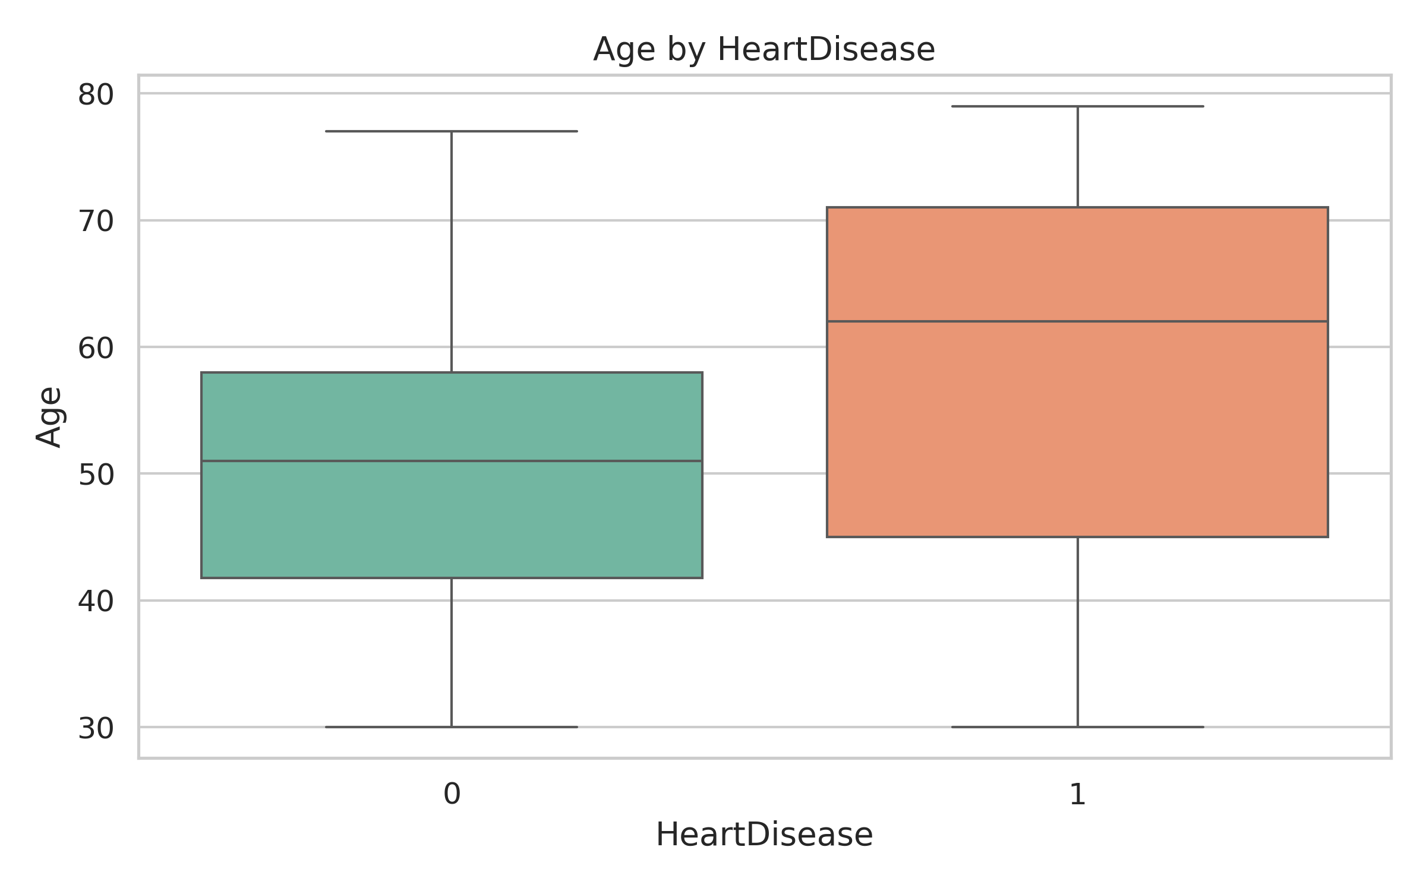
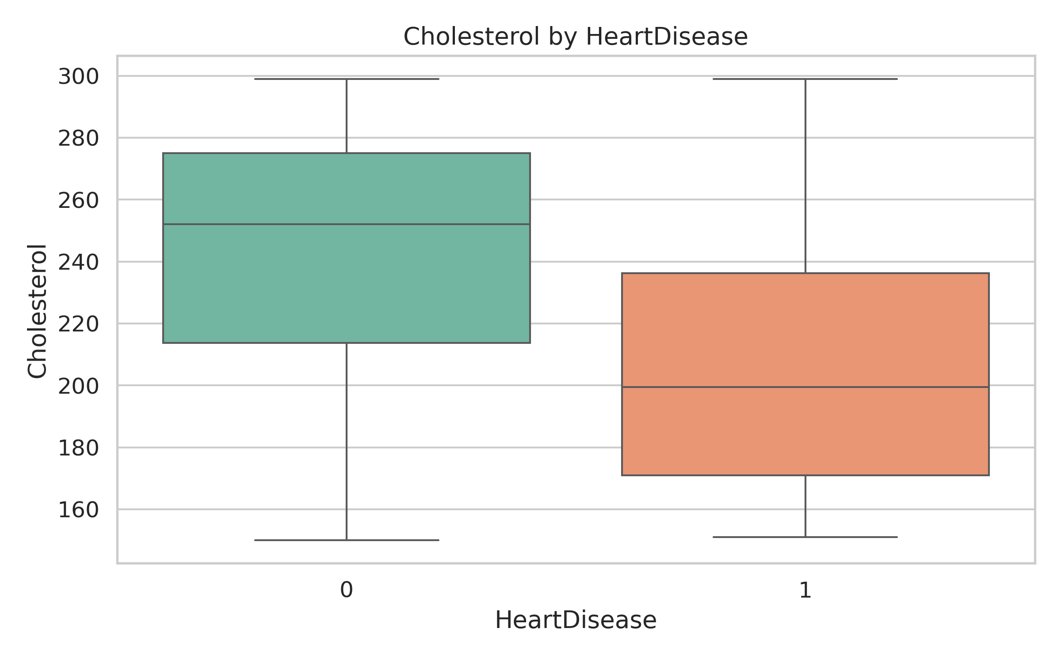
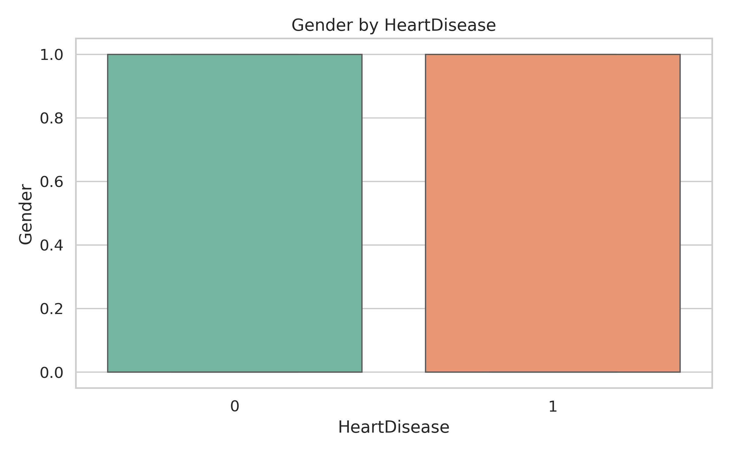
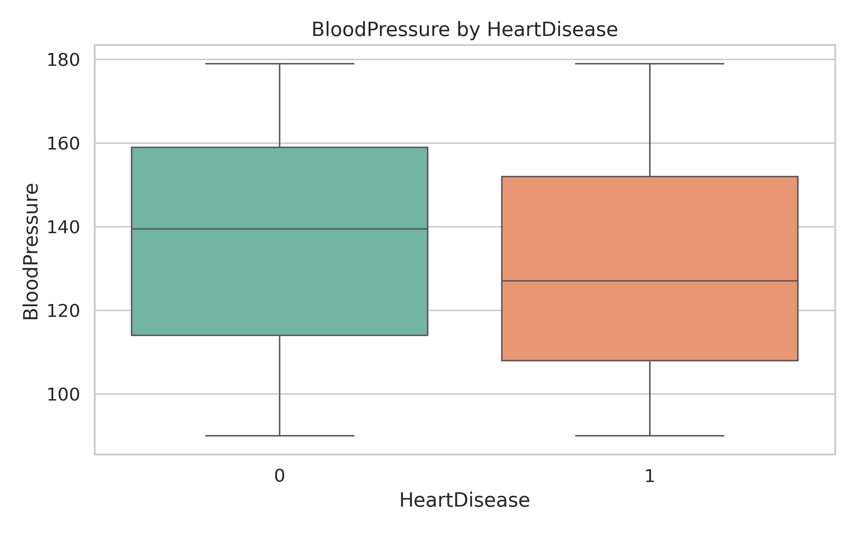
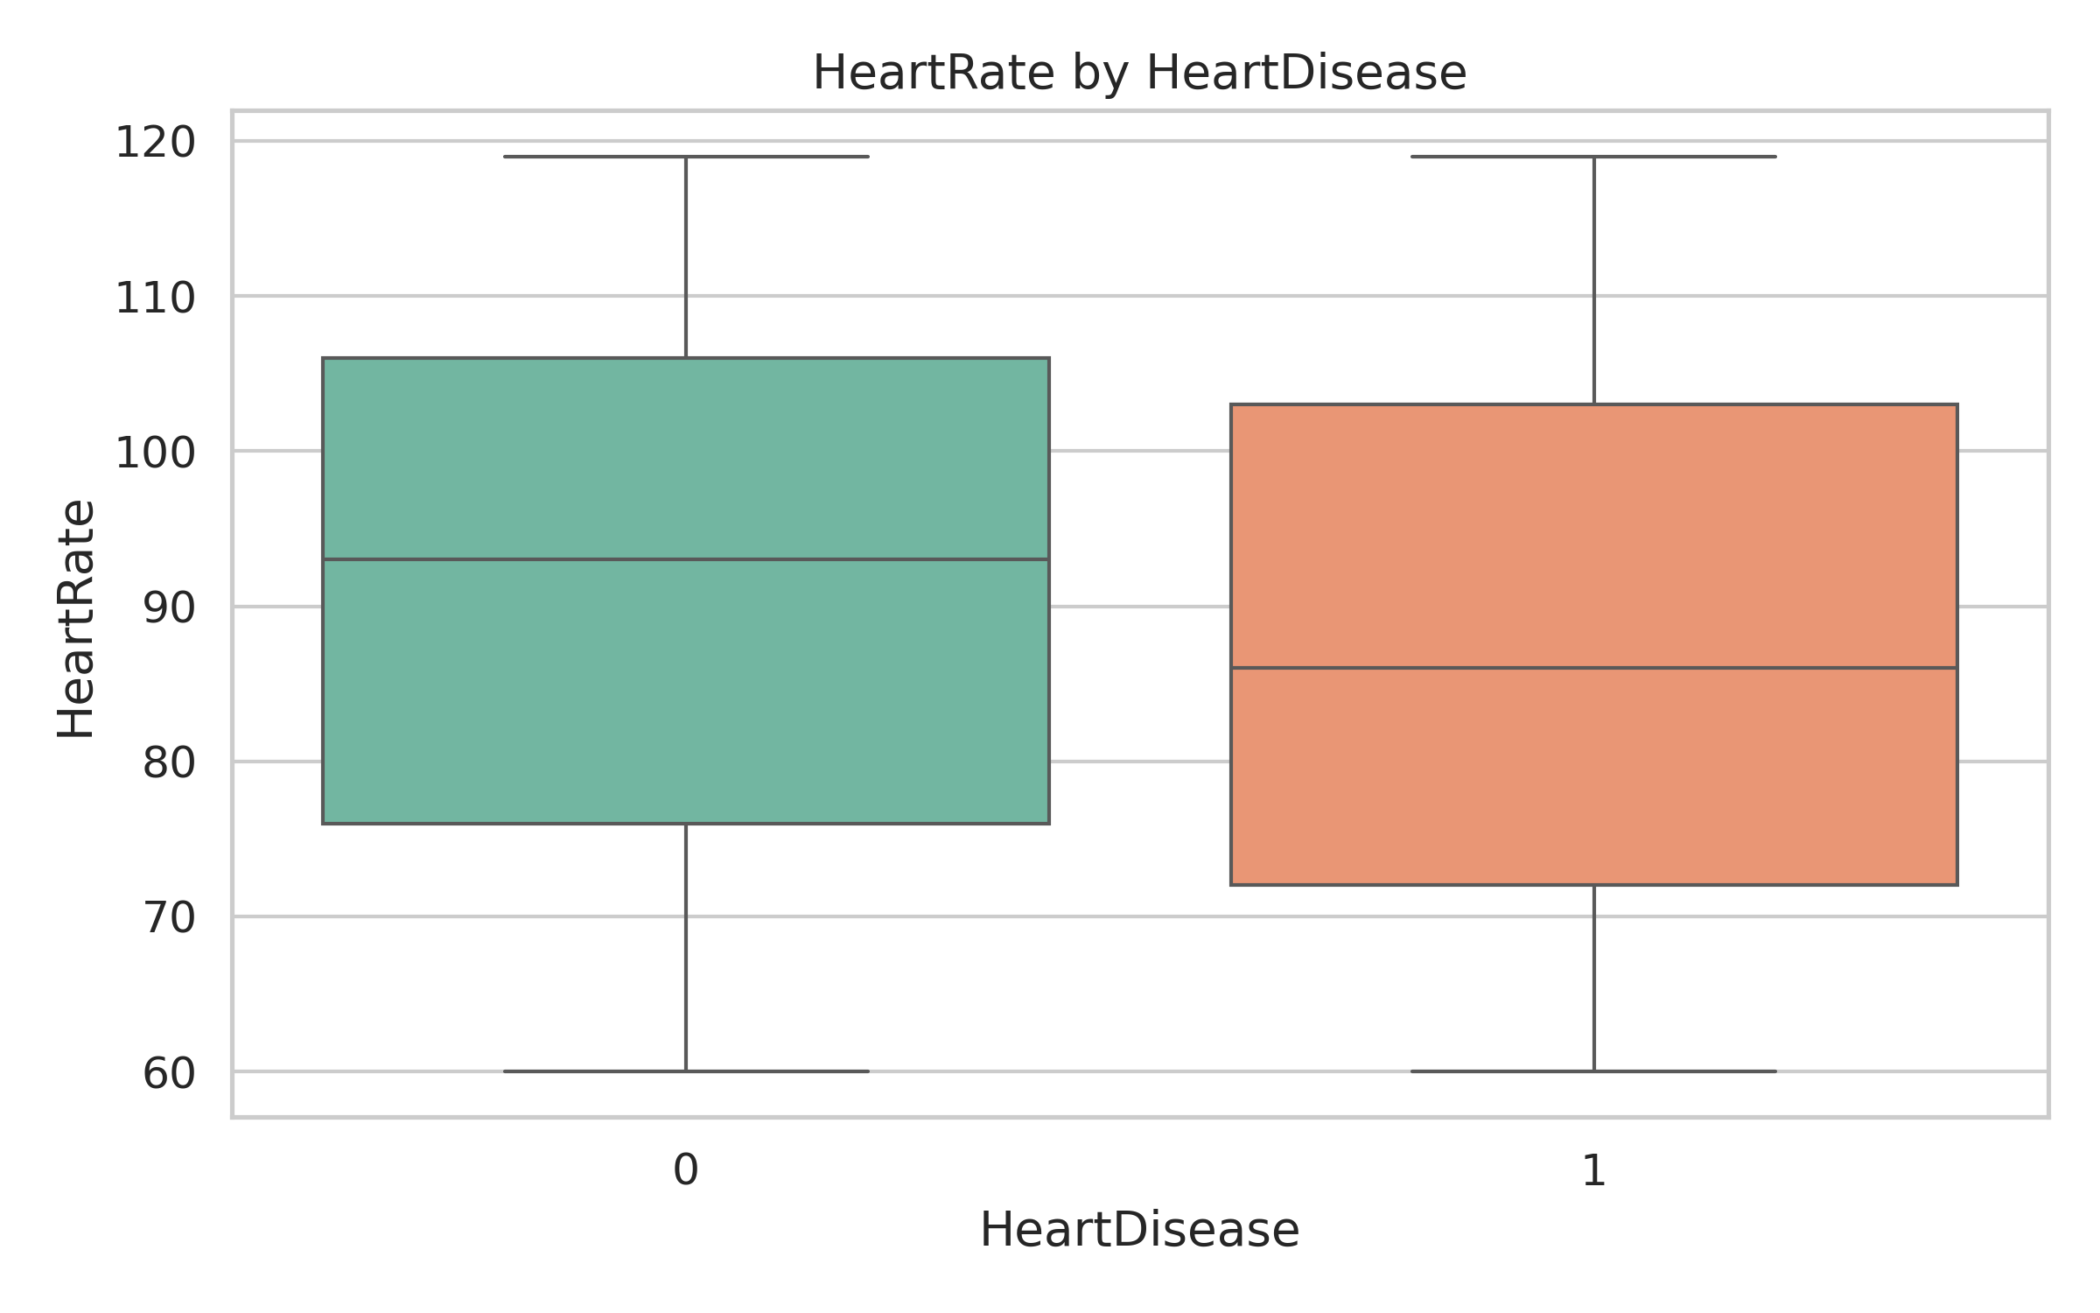
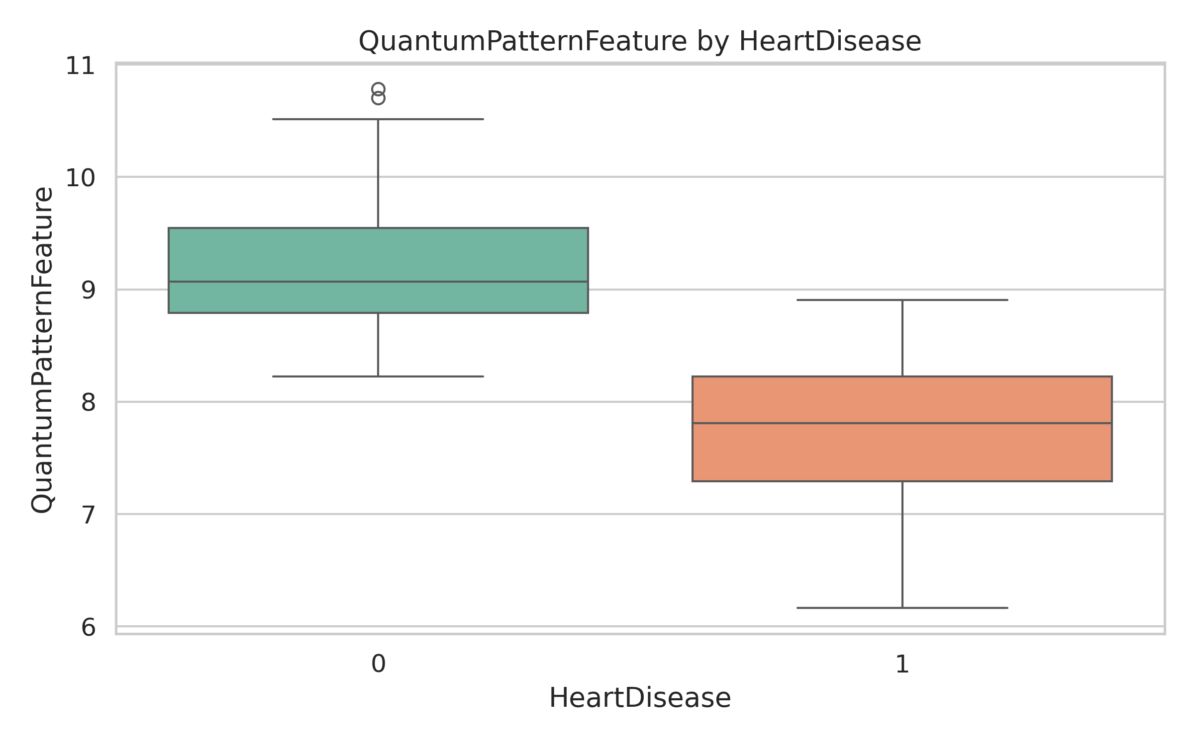
Exploratory Data Analysis

Slide 4
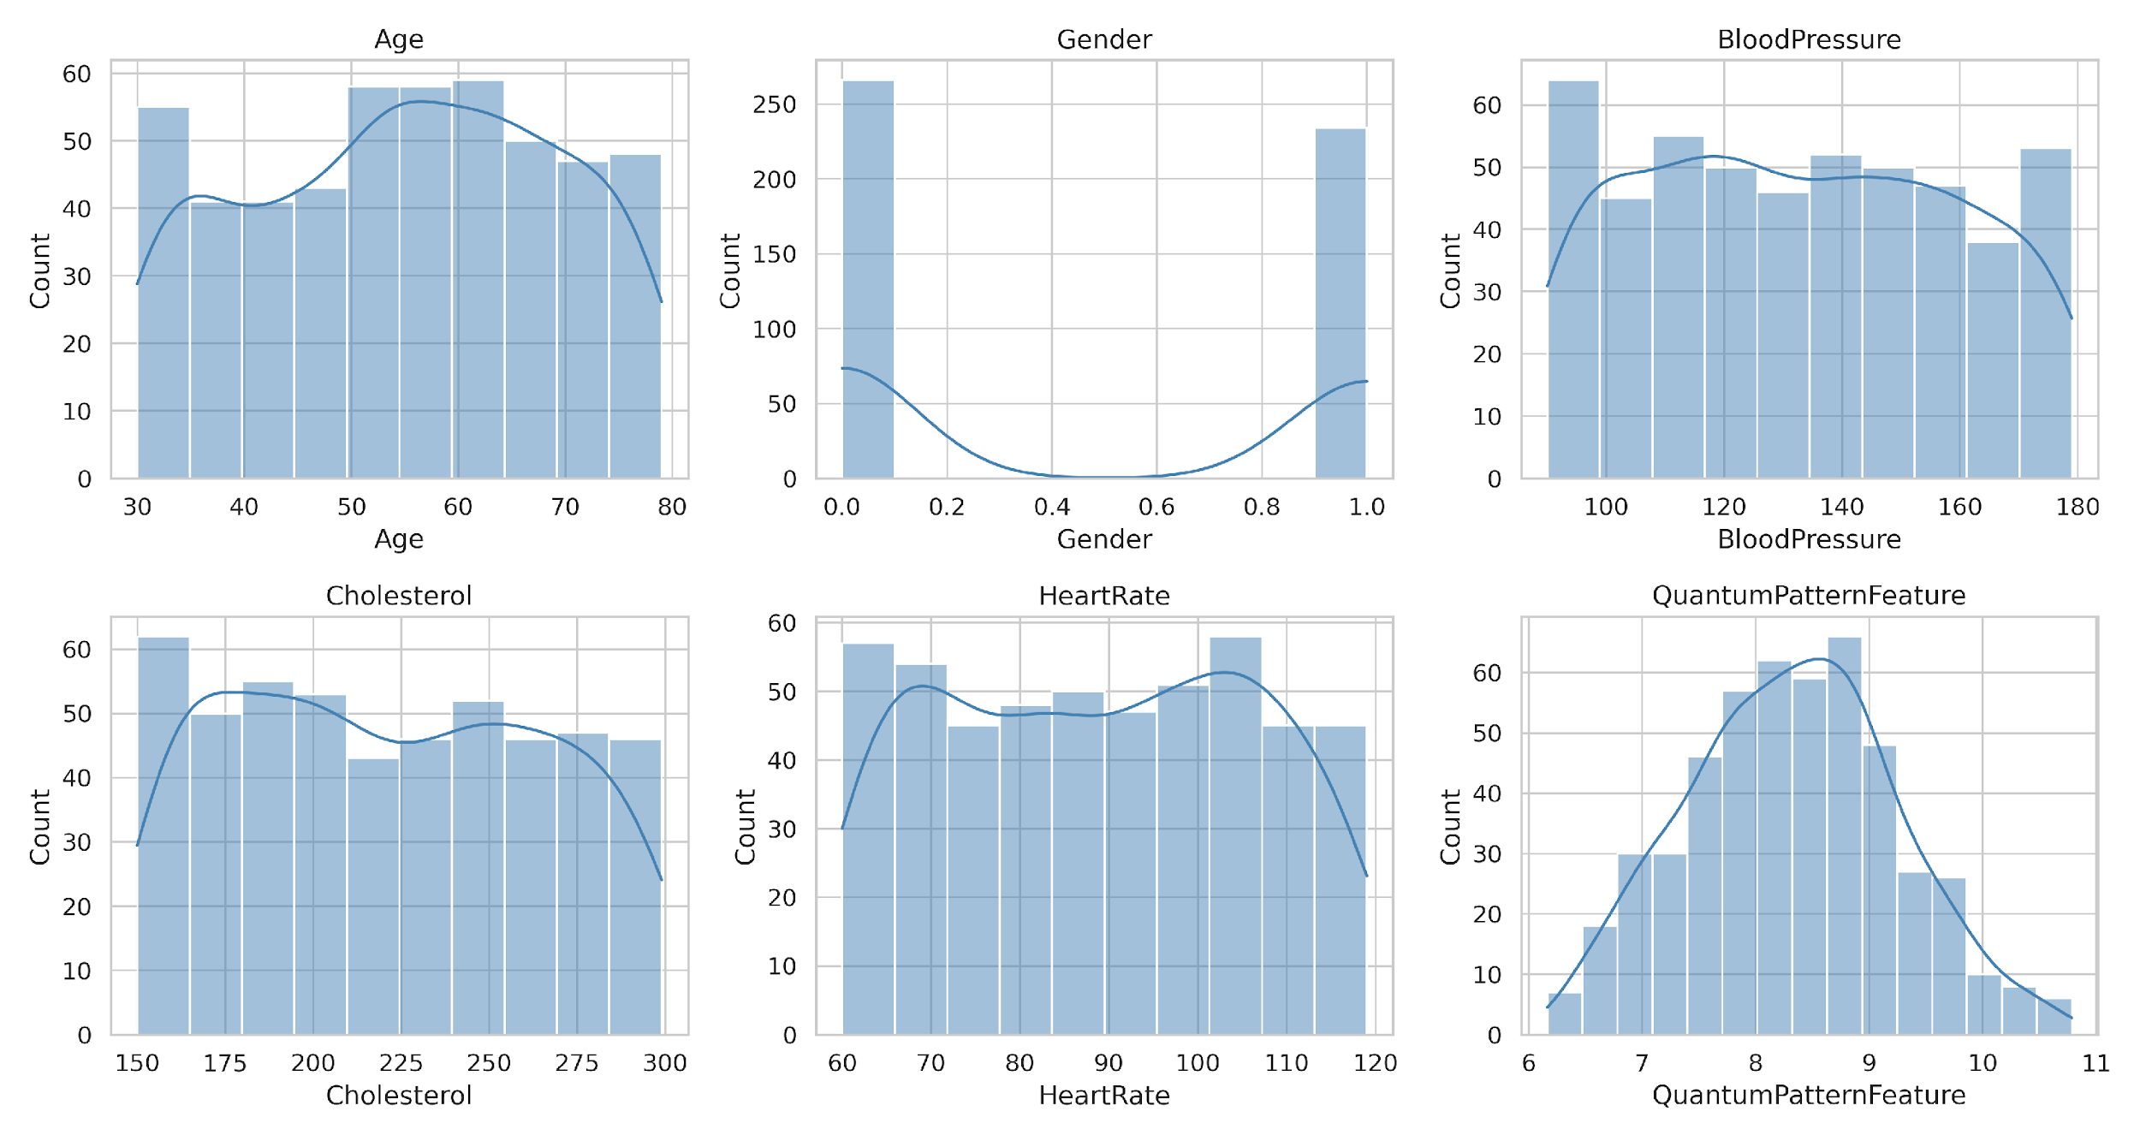
Dataset Histogram

Slide 5
Correlation Analysis
Correlation measures the statistical relationship between two variables.
It tells us how strongly two variables are related and in what direction.
Correlation Coefficient: A value between -1 and +1.)
+1 (Positive Correlation): As one variable increases, the other also tends to increase.
-1 (Negative Correlation): As one variable increases, the other tends to decrease.
0 (No Correlation): No linear relationship between the variables.

Slide 6
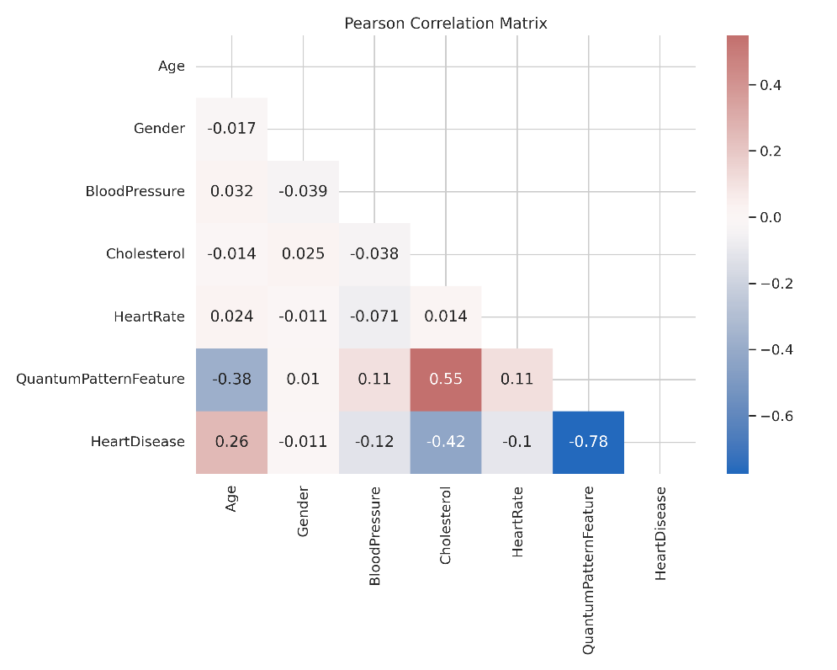

Correlation Analysis

Slide 7
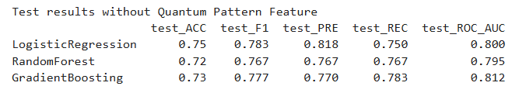
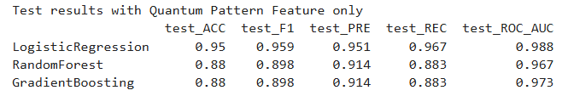
Correlation Analysis
The Quantum Pattern Feature shows a remarkably strong and direct correlation with heart disease incidence. Its presence significantly impacts model performance:
Without Quantum Pattern Feature:
Test accuracy drops below 75%.
With Quantum Pattern Feature alone:
Test accuracy ranges between 88-95%.

Slide 8
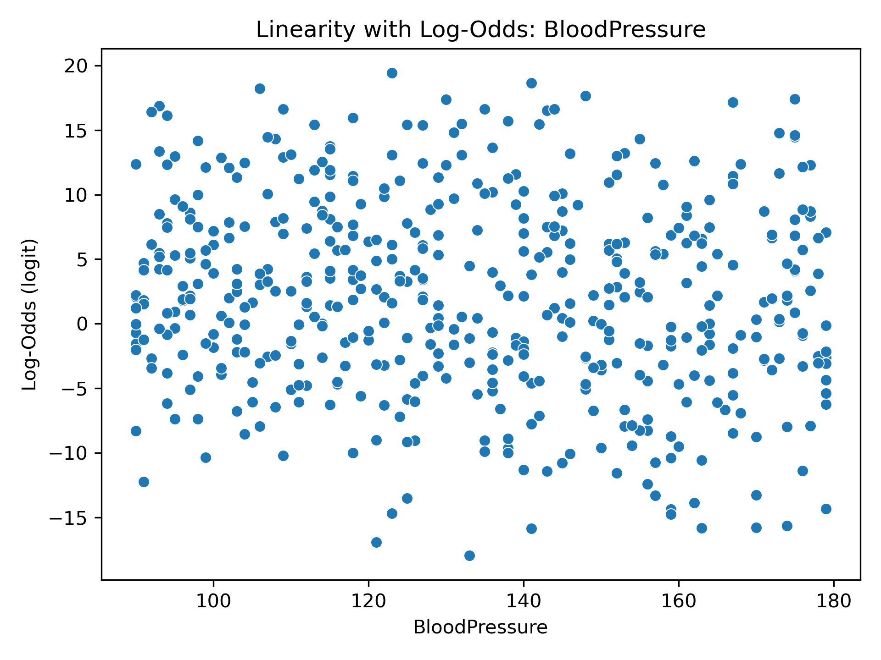
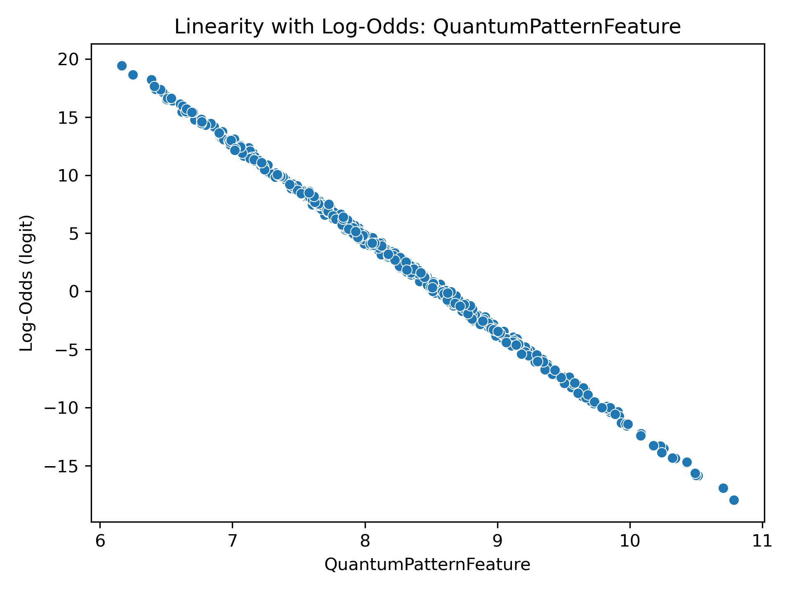
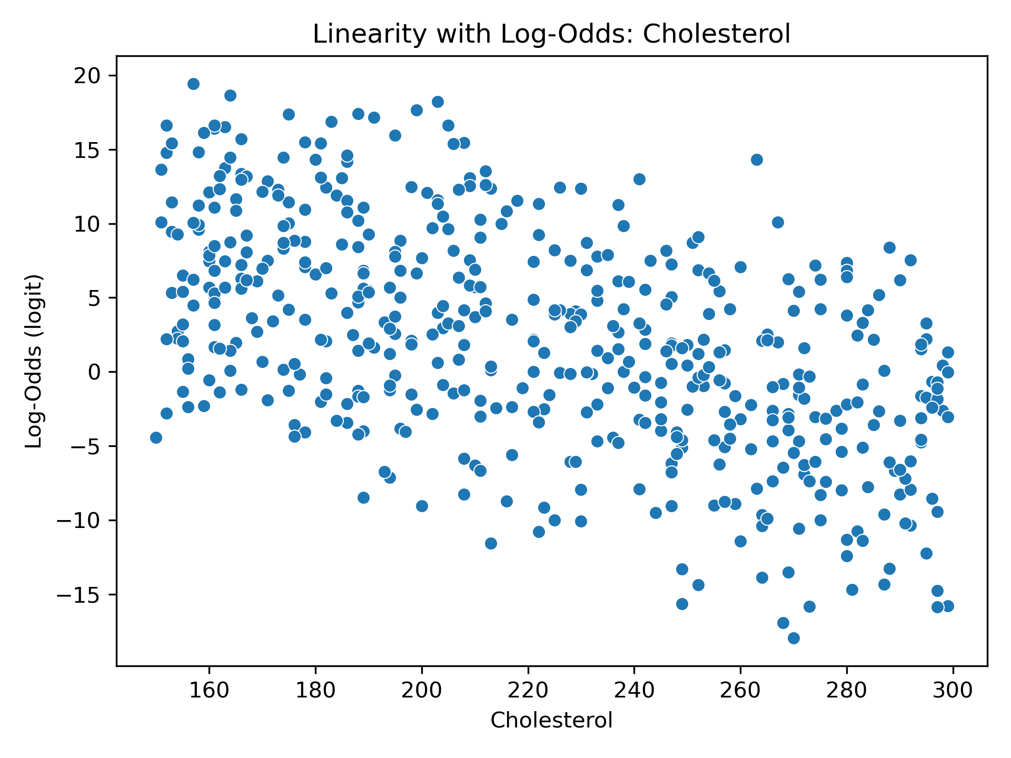
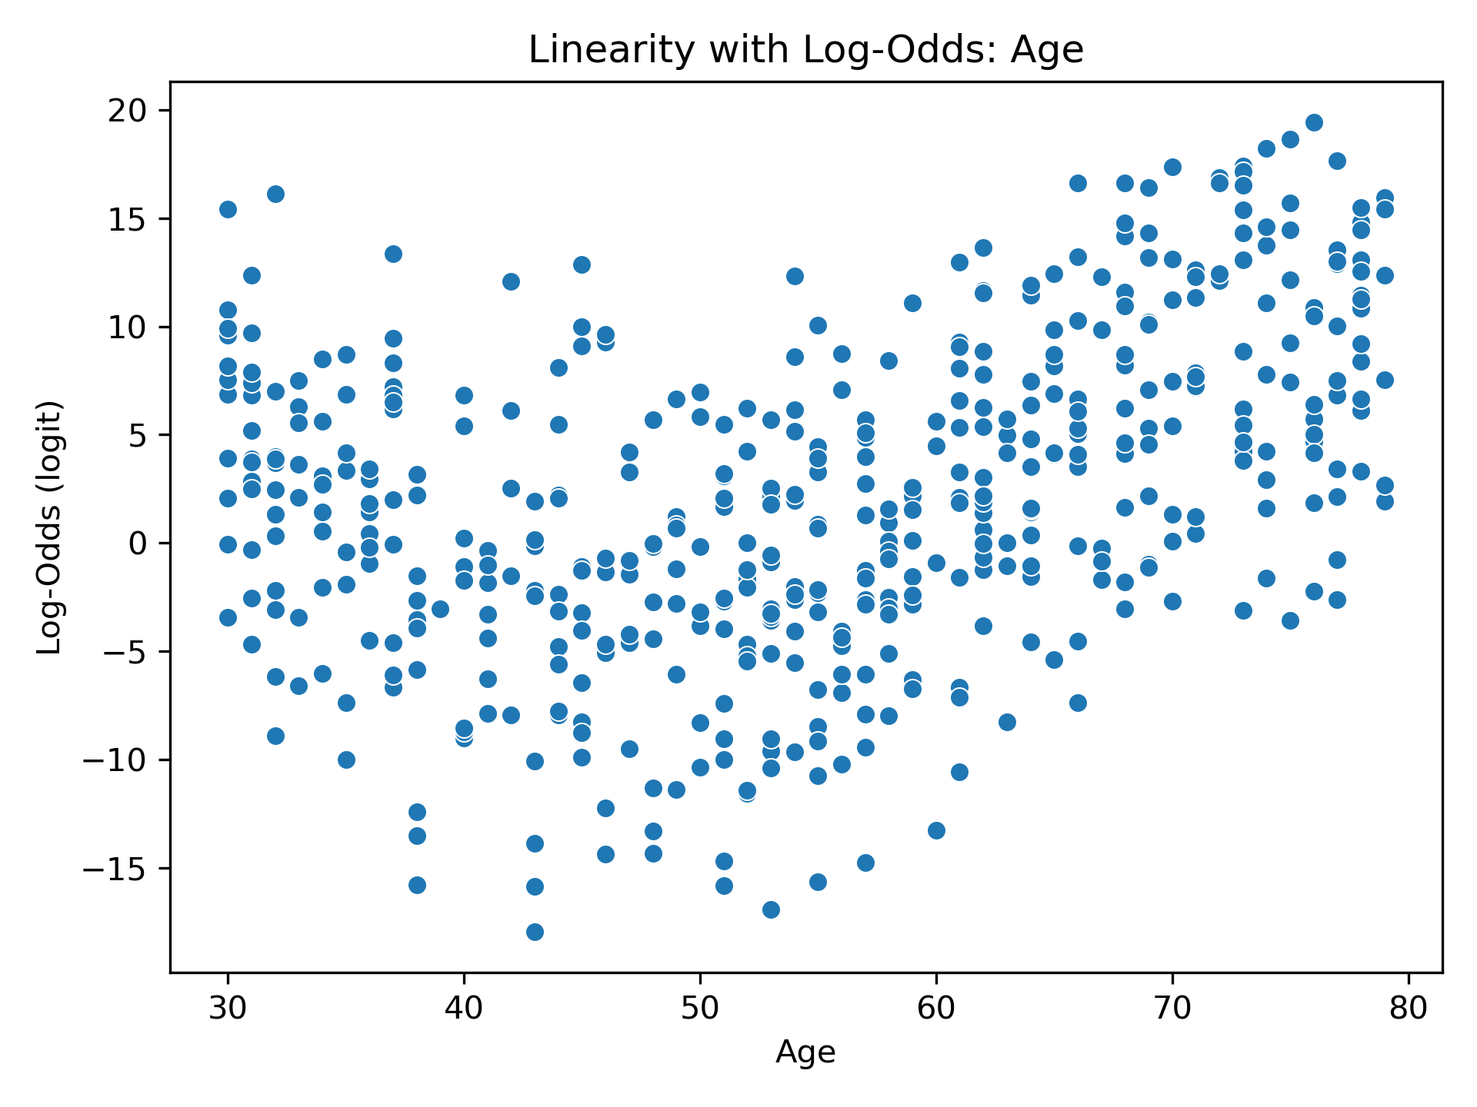
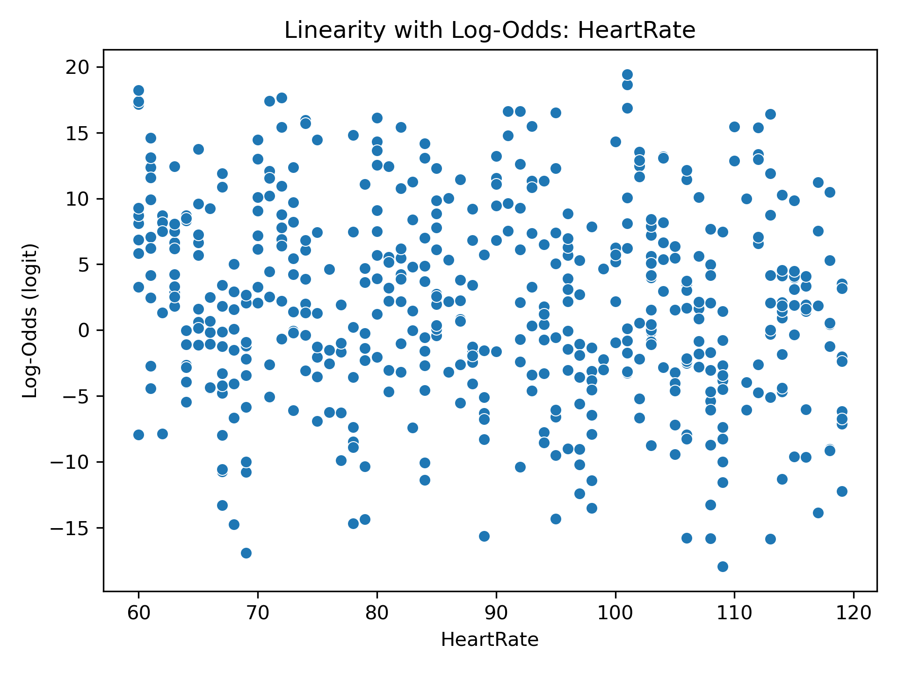
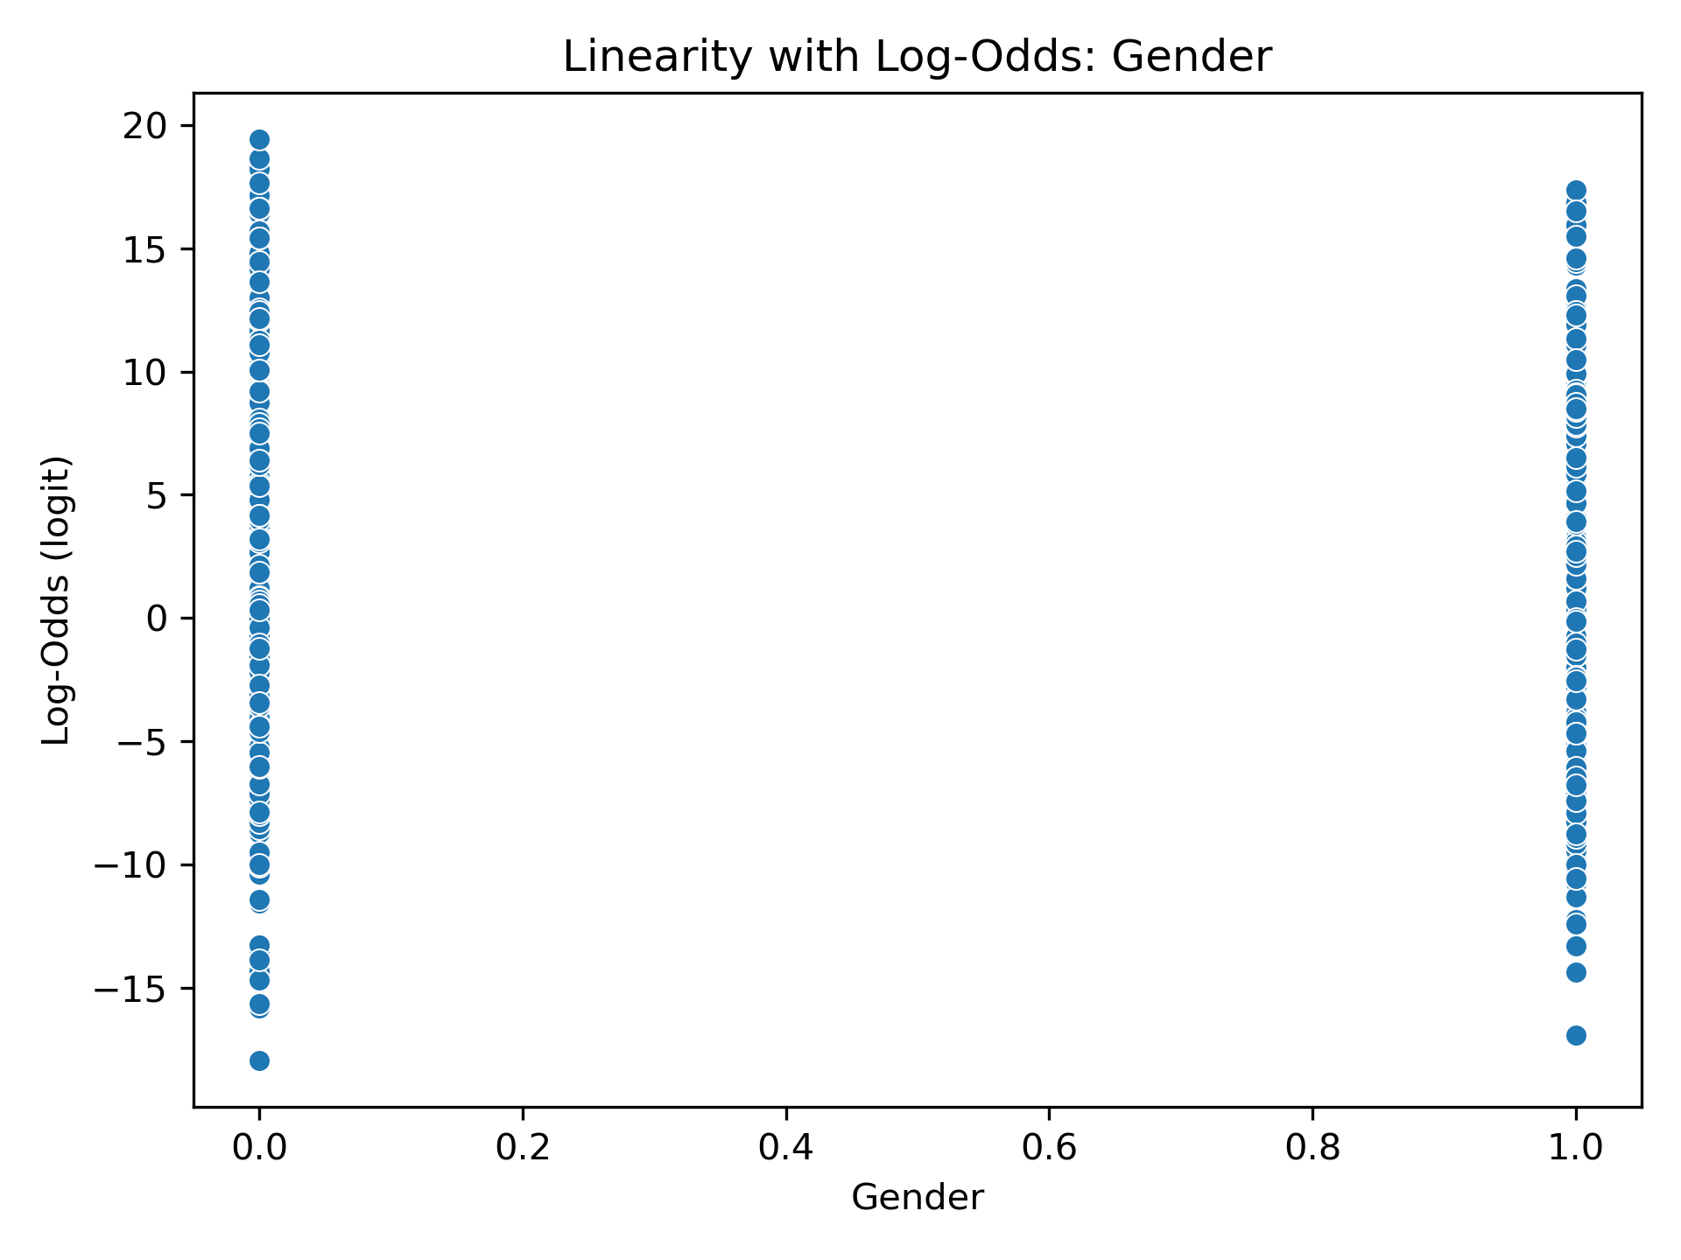
Verifying Logistic Regression Assumptions I. – Log Odds

Slide 9
Verifying Logistic Regression Assumptions II. – VIF Scores
Features | VIF Scores
Quantum Pattern Feature | 1.8998411936346686
Cholesterol | 1.5718910309784253
Age | 1.2742621060936101
Blood Pressure | 1.0500700866670132
Heart Rate | 1.0358010533472983
Gender | 1.0025454923698582

Slide 10
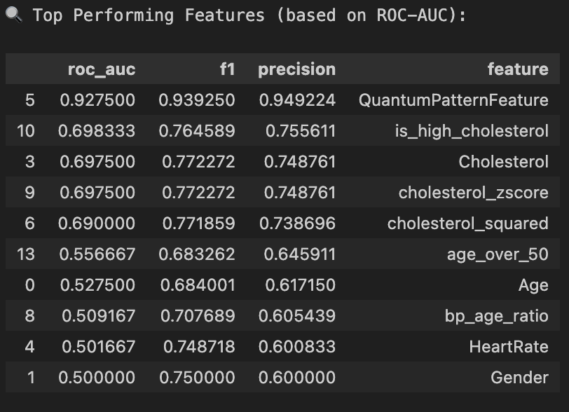
Feature Engineering
Key Engineered Features for Better Prediction
cholesterol_squared
Added to capture nonlinear risk from high cholesterol
Extreme values may impact heart disease more than linearly assumed
age_bp_interaction
Reflects how aging and high blood pressure can combine to increase risk
Captures hidden patterns that raw features might miss

Slide 11
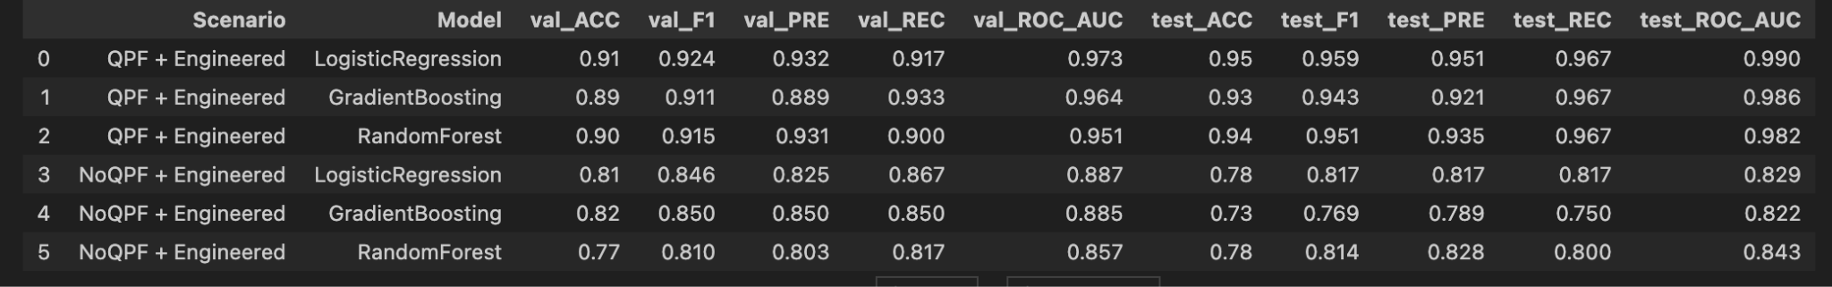
Engineered Features: Do They Improve Accuracy?
Logistic Regression remained the top-performing model (ROC-AUC ≈ 0.99)
Engineered features slightly improved validation metrics but did not enhance test performance

Slide 12
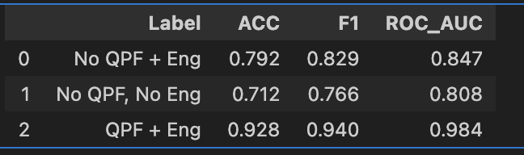
Engineered Features: Do They Improve Accuracy?
Engineered features improved accuracy, F1, and ROC-AUC
Captured nonlinear patterns (cholesterol_squared)
Modeled clinical interactions ( age × BP)
Enabled better separation of risk groups even without QPF

Slide 13
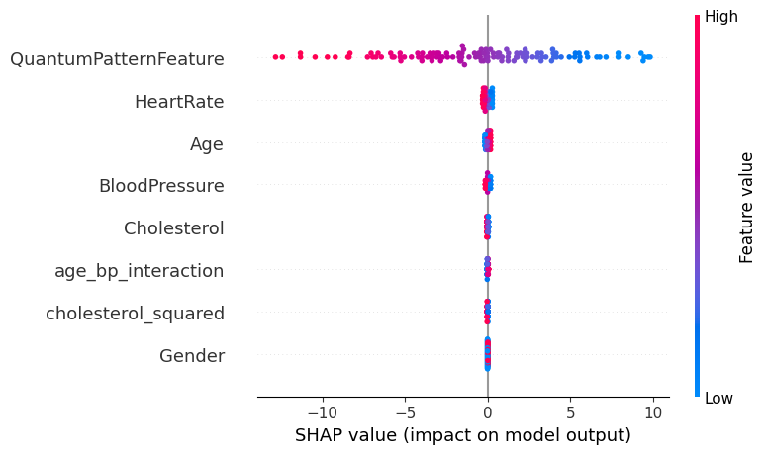
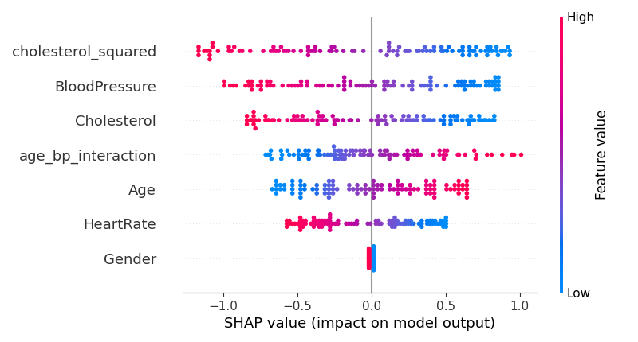
Engineered Features: Do They Improve Accuracy?
QuantumPatternFeature (QPF) already captures most signal
SHAP confirms added value from engineered features

Slide 14
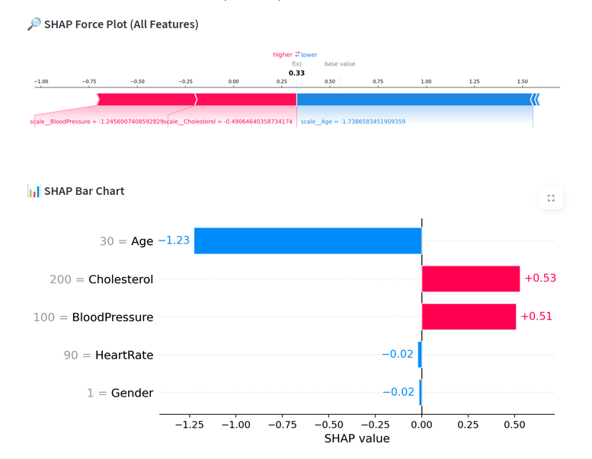
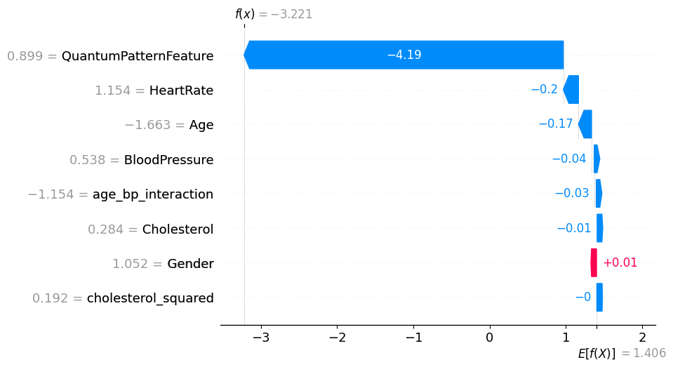
SHAP For Samples

Slide 15
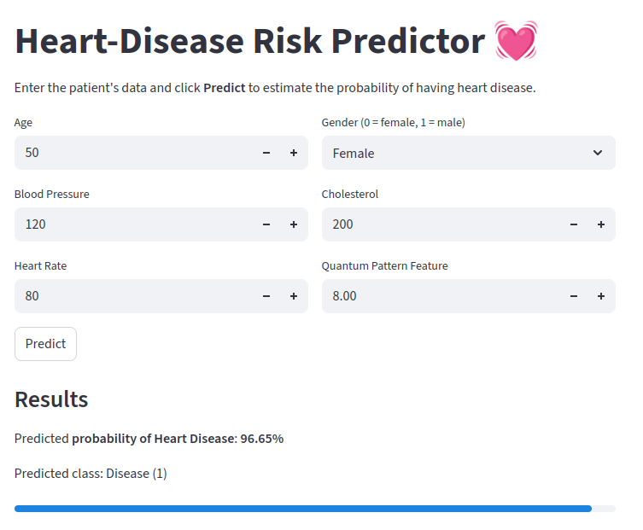
Demo

Slide 16
Thanks For Your Attention!
Q&A

